Slide 1
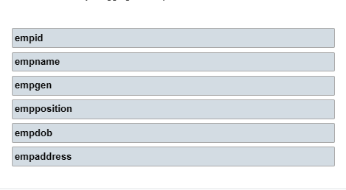

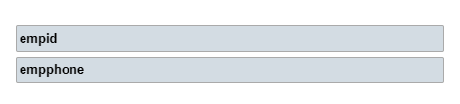
2. Data analysis
. Table Employee
. Table Employee contact

Slide 2
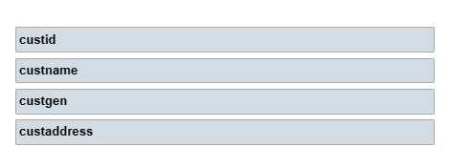
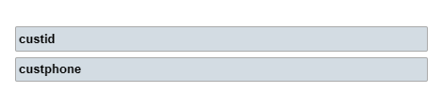
2. Data analysis
. Table Customer
. Table Customer contact

Slide 3
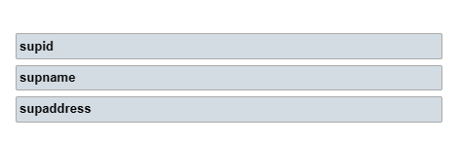
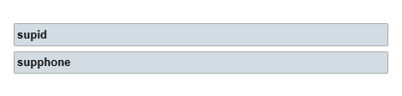
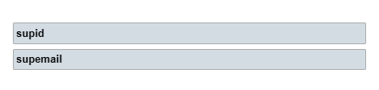
2. Data analysis
. Table Supplier
. Table Supplier Contact

Slide 4
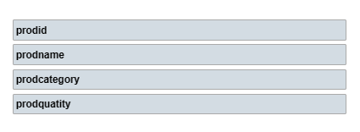
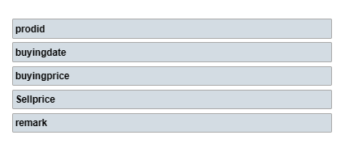
2. Data analysis
. Table Product
. Table Buying price

Slide 5
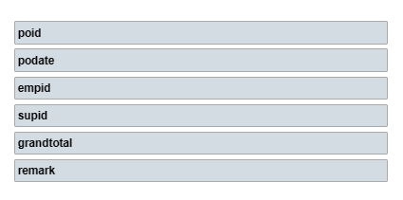
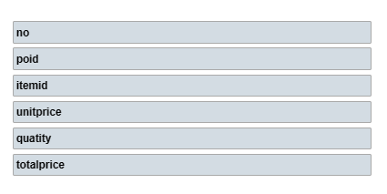
2. Data analysis
. Table Purchase Order
. Table PO Detail

Slide 6
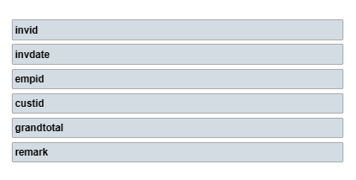
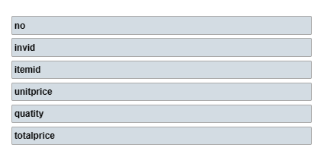
2. Data analysis
. Table Invoice
. Table Invoice Detail

Slide 7
3. ER-Diagram
empid
empaddress
empname
empdob
tbl_employee
empgen
empphone
empposition
empphone
empEmail
empemail

Slide 8
3. ER-Diagram
custid
custaddress
custname
tbl_customer
empphone
custgen
custphone

Slide 9
3. ER-Diagram
supid
custaddress
supname
tbl_supplier
empphone
empphone
supemail
supphone

Slide 10
3. ER-Diagram
prodid
quantity
tbl_product
prodname
prodcategory

Slide 11
3. ER-Diagram
prodid
remark
pricingdate
tbl_buyingprice
saleprice
buyingprice

Slide 12
3. ER-Diagram
poid
remark
podate
tbl_purchase_order
grandtotal
empid
supid

Slide 13
3. ER-Diagram
no
total_price
poid
tbl_po_detail
quantity
itemid
unitprice

Slide 14
3. ER-Diagram
invid
remark
Invdate
tbl_invoice
grandtotal
empid
custid

Slide 15
3. ER-Diagram
no
total_price
invid
tbl_inv_detail
quantity
itemid
unitprice

